Slide 1
Year 7 – Liveability Week 1, Term 2

Slide 2
Quick Tips
Remember when you are completing the lesson worksheets and the ‘Revision Task Worksheet’ to address the question being asked.
Reminder about what words mean.
KEY DIRECTIONAL WORDS
Account (account for) – state reasons for. Give an account of.
Calculate – ascertain/determine from given facts, figures of information
Define – state the meaning and essential qualities
Describe – provide characteristics and features
Evaluate – make a judgement based on criteria; determine the value of
Explain – relate cause and effect; make the relationships between things evident; make the meaning clear; provide why and/or how
Identify – recognise and name
List – provide a series of related word, names, numbers or items that are arranged in order, one after the other.
Outline – Indicate the main features of

Slide 3
LESSON 1 – Week 1, Term 2

Slide 4
Learning intentions & Success criteria 
LEARNING INTENTIONS
Explore what ‘liveability’ is.
Look at factors influencing liveability and decisions people make.
SUCCESS CRITERIA
Be able to define ‘liveability’.
Be able to provide factors that influence people’s decisions about where to live.
Rank factors influencing where people choose to live.

Slide 5
Definition – Liveability 
'Liveability' - the qualities of a place (city, town, suburb, neighbourhood) that contribute to the quality of life experienced by residents and others.

Slide 6
Where to live – What influences the decision? 
There are many factors people think about before selecting or choosing where to live.
Most common factors affecting the choices people make about where to live include:
Distance from family and friends
Affordability – e.g. the cost
Attachment to a place – e.g. a place visited on a holiday, where a person grew up.
Employment opportunities including types of jobs.
Stage of life – e.g. age
Lifestyle considerations – e.g. prefer living in a rural area or coastal lifestyle
Personal safety – e.g. level of crime
Travel time and transport options – e.g. access to public transport
Culture and ethnicity
Climate and other environmental factors – e.g. weather, hills or mountains.

Slide 7
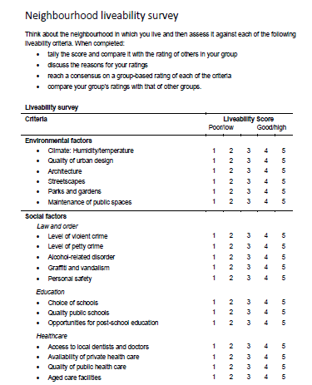
How liveable is your town?
Complete the survey relating to liveability in your town – Neighbourhood Liveability Survey
https://www.geogspace.edu.au/verve/_resources/2.3.3.6_1_assessing_liveability_survey.pdf
*** Complete the ‘Lesson 1 – Worksheet’ to state information about your findings.

